Slide 1
Chapter 1
Introduction to Electronics

Slide 2
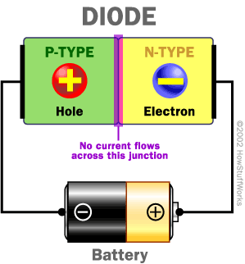
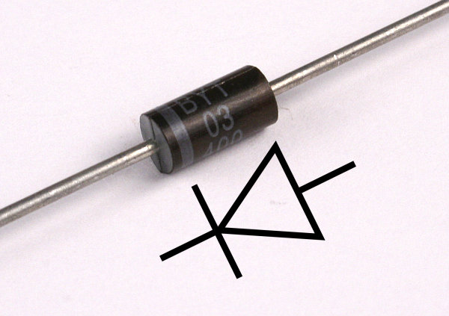
PN Junction - Diode
Current Flow

Slide 3
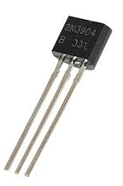
Bipolar Junction Transistor: BJT
Emitter
Collector
Base

Slide 4
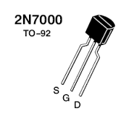
Field Effect Transistor: FET
S = Source
G = Gate
D = Drain

Slide 5
Passive and Active Components
Passive Components:
Do no require/depend on power supply for its operation or the device which electrical characteristics does not depend on the power supply
Examples: Resistor, capacitor, inductor
Active components:
Do require/depend on power supply for its operation or the device which electrical characteristics depend on the power supply
Examples: Transistors such as BJT and FET

Slide 6
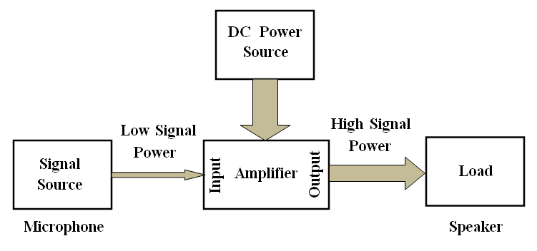
Electronic Circuits
An electronic circuit generally contains both the passive and active components. Therefore a dc power supply is essential for the operation of its active components. An electronic processing or amplifier devices also need different power source than its DC operating power source called input signal.
This input signal characteristics and power can be modified by the electronic circuit with the presence of its DC operating power supply. The processed input signal which is obtained from the electronic circuit is called output signal.
Block diagram of an electronic circuit (Amplifier)

Slide 7
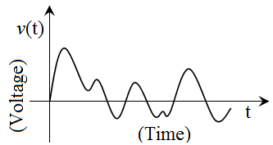
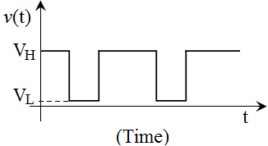
Analog and Digital Signals
An electrical signal is a time varying voltage or current which bears the information by altering the characteristics of the voltage or current. In an analog signal the characteristics of the voltage or current which represents the information can be any value.
Analog signal
Digital signal must have discrete value, it is said quantization. In a digital signal the characteristics of the voltage or current which represents the information has only two values and sometimes it is called binary signal.
Digital signal

Slide 8
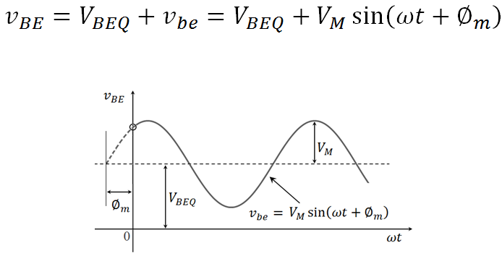
Representation of Signal
A sinusoidal voltage when it is superimposed on a DC voltage can be represented as
Sinusoidal voltage superimposed on dc voltage VBEQ

Slide 9
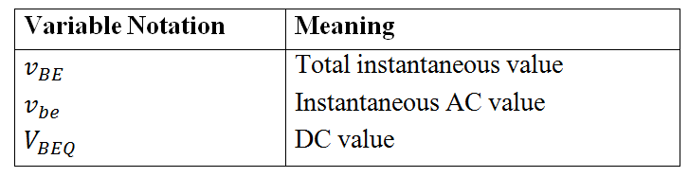

Slide 10

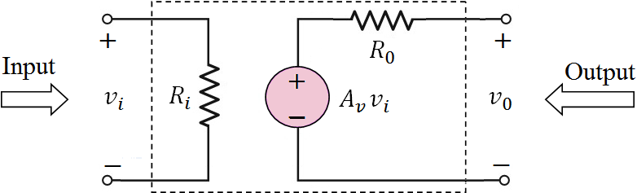
Amplifier Characteristics
The voltage gain of the amplifier is defined as the ratio between output voltage and input voltage, mathematically
The gain of a voltage amplifier is unit less (there is no unit)
Equivalent circuit of a voltage amplifier

Slide 11
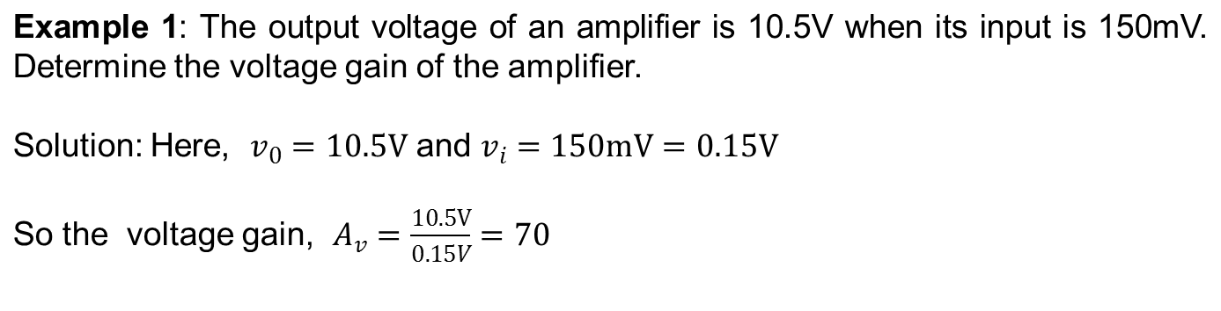
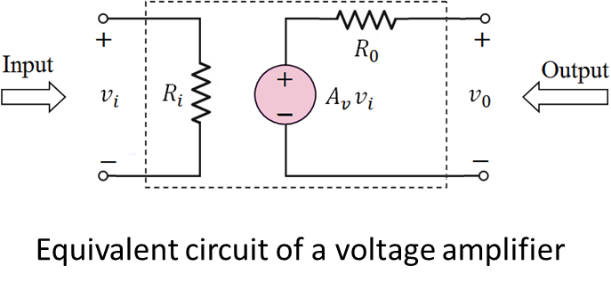

Slide 12
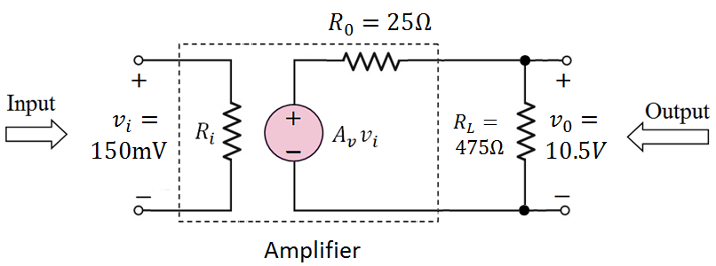
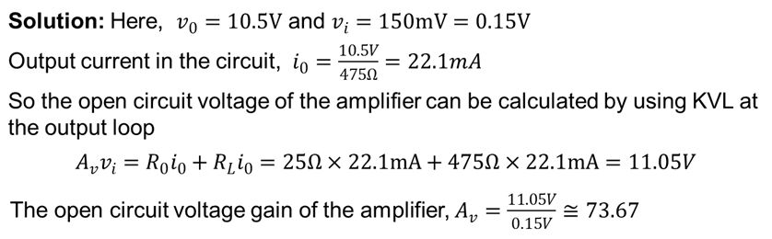
Example 2: A load resistance of 475Ω is connected with the output of a voltage amplifier as shown in the Figure. The output voltage across the load resistance is 10.5V when the amplifier input is 150mV. Determine the open circuit voltage gain, A_{V} of the amplifier. Assume that the output resistance of the amplifier is 25Ω.

Slide 13
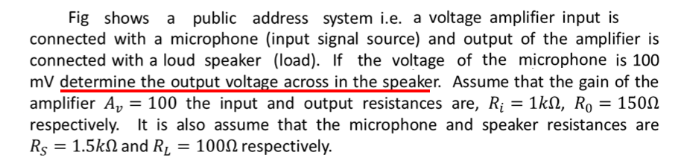
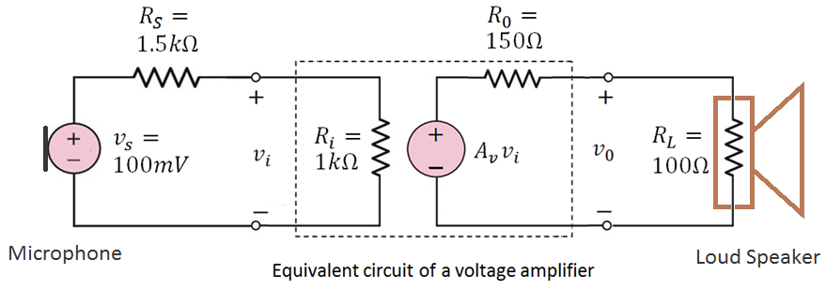
The figure shows
Must calculate v_{i}
Calculate the open circuit voltage, A_{v} v_{i}
Then use voltage divider to find out the voltage across R_{L}
Answer: 1.6V

Slide 14
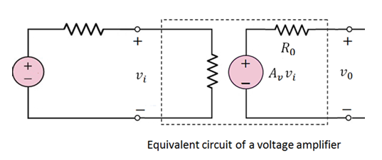
Ex. 1: The open circuit voltage of a voltage amplifier is 7.5V when its input is connected to a signal source. Assume that the signal source voltage is 3.0V and its resistance is 1.5kΩ respectively. If the input resistance of the amplifier is 5kΩ, what would be the voltage gain of the amplifier.
R_{S} = 1.5kΩ
R_{i} = 5kΩ
v_{S} = 3V
v_{o} = 7.5 V
Must calculate v_{i}
We know that the open circuit voltage, A_{v} v_{i} = 7.5 V
Calculate A_{V}
Answer: 3.25

Slide 15
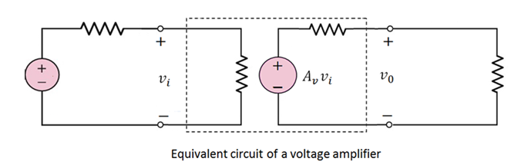
Ex. 2: The open circuit voltage of a voltage amplifier is 12.5V when its input is connected to a signal source. Assume that the signal source voltage is 2.5 V and its resistance is 2.0kΩ respectively. If the input and output resistance of the amplifier is 5kΩ and 50Ω respectively.
Calculate the value of Av
The amplifier output is connected to drive a load resistance 500Ω, determine the output voltage across the load resistance.
R_{S} = 2.0kΩ
R₀ = 50 Ω
R_{i} = 5kΩ
R_{L} = 500 Ω
v_{S} = 2.5 V
= 12.5 V
Calculate the value of v_{i}
We know that the open circuit voltage, A_{v} v_{i} = 12.5 V
Use KVL or voltage divider to calculate output across the load.
Answers:
A_{V} = 7
Voltage across load = 11.36 V

Slide 16

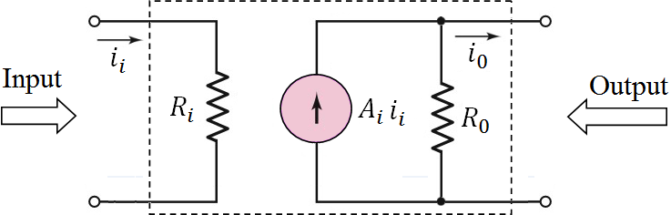
Amplifier Characteristics Cont.
An equivalent circuit of a current amplifier is shown in bellow. This amplifier is mainly used to amplify the current. The input parallel resistance of the amplifier is very low and the output parallel resistance is very large, these characteristics are essential for a current amplifier. The current gain of the amplifier is defined as the ratio between output current and input current, mathematically
The gain of a current amplifier is unit less. (There is no unit)
Equivalent circuit of a current amplifier

Slide 17
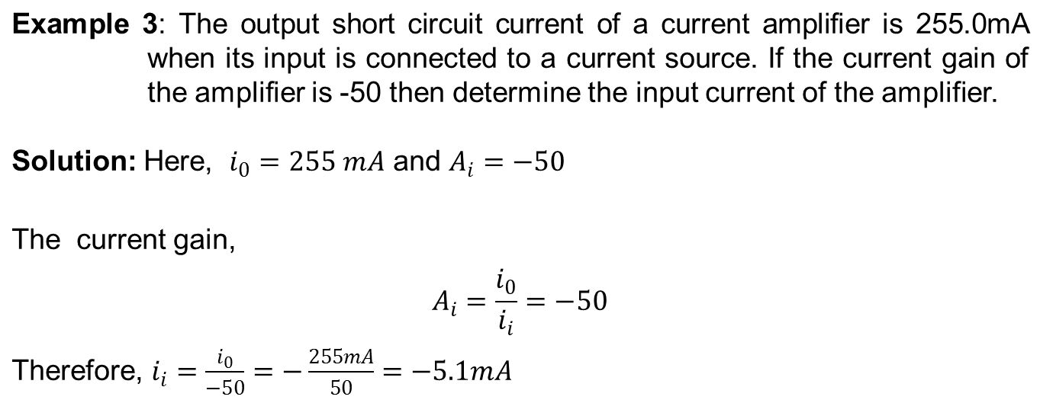
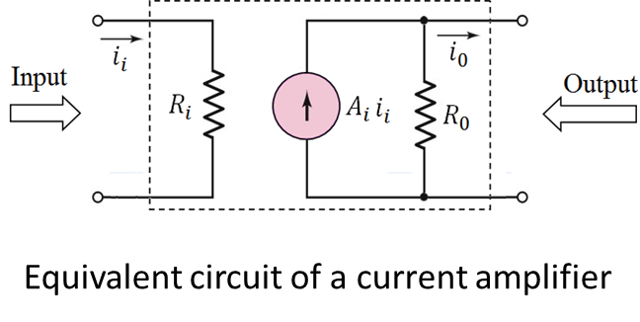
Example 1:

Slide 18

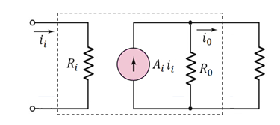
Example 3:
The input current, i_{i} is 0.5 mA
R_{O} = 2.5 kΩ
R_{L} = 450 Ω
Calculate the value of the short circuit current, A_{i} i_{i}
Use current divider to calculate i_{o}
Use Ohm’s Law to find output voltage.
Answer: 5.72 V

Slide 19

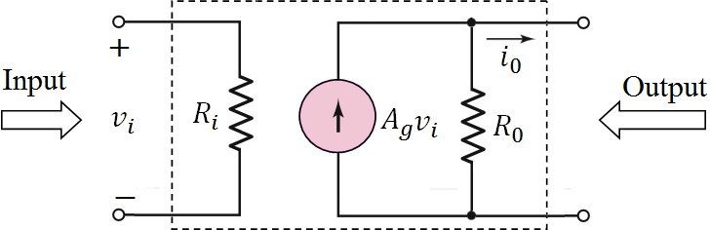
Amplifier Characteristics Cont.
An equivalent circuit of a transconductance amplifier is shown bellow. This amplifier input parallel resistance is very large and the output parallel resistance is also very large, these characteristics are essential for a transconductance amplifier. The gain of the amplifier is defined as the ratio between output current and input voltage, mathematically.
The unit of the transconductance amplifier gain is A/V or Siemens.
Equivalent circuit of a transconductance amplifier

Slide 20

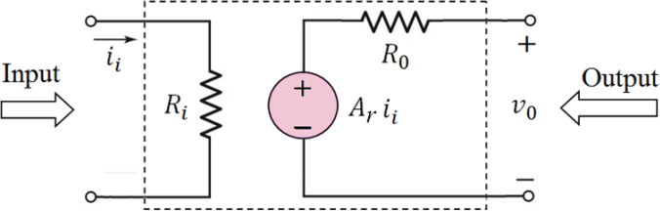
Amplifier Characteristics Cont.
An equivalent circuit of a transresistance amplifier is shown in bellow. This amplifier input parallel resistance is very low and the output series resistance is also very low, these characteristics are essential for a transconductance amplifier. The gain of the amplifier is defined as the ratio between output voltage and input current, mathematically
The unit of the transresistance amplifier gain is V/A or Ohm.
Equivalent circuit of a transresistance amplifier

Slide 21
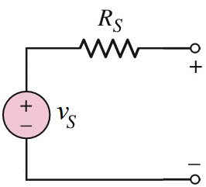
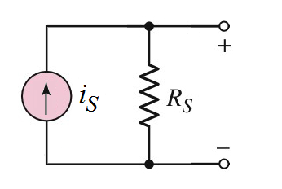
Signal Source or Generator
A voltage source is modeled by a voltage generator with a series resistance called source resistance as shown in bellow. For an ideal voltage source the series resistance is 0. A voltage source can be replaced by an equivalent current source using Norton theorem.
Voltage source
Similarly, a current source is modeled by a current generator with a parallel resistance called source resistance as shown in bellow. For an ideal current source the parallel resistance is infinite. A current source can be replaced by an equivalent voltage source using Thevenin theorem.
Current source

Slide 22
EXAMPLE
The short circuit current of a current amplifier is 100 mA when its input is connected to a signal source. The voltage of the signal source is 10 V and its resistance is 3 kΩ. The input and output resistances of the amplifier are 1 kΩ and 100 Ω respectively.
Draw the schematic of the amplifier circuit including the source.
Calculate the short circuit current gain of the amplifier
Determine the output current and voltage of the amplifier when a 25 Ω load resistor is connected at the output.

Slide 23
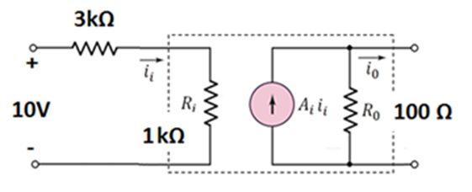
i_{o} = 100 mA
i_{i} = 10 / 4k = 2.5 mA
A_{i} = i_{o} / i_{i} = 40
A_{i}i_{i} = 100 mA
Current divider - current at load resistor = [100 / 125] (100mA) = 80 mA
Ohm’s law→ Voltage at the load resistor = 80m (0.025k) = 2 V

